Slide 1
Are you too sure to insure?
Supervised machine learning : Binary Classification algorithm
Greyatom hackathon 1
Team Name : Group four
Contributors : Ramesh, Girish, Sunit, Jainam

Slide 2
Problem statement
SafeTravel Inc. is one of the world's largest insurance companies specializing in travel insurance.
They receive thousands of claims spread across different products. Wrongly denying a genuine claim could lead to lawsuits against the company and approving the wrong claim would lead to a loss.
Automatically predicting the claims could lead to a lot of benefits and solve some other supplementary problems too.
Requirement is to define a machine learning model which should automatically predict the claim for business which would help to take a decision as to sanction the insurance or not.

Slide 3
Dataset and Data dictionary (List of features available for analysis and prediction) The training dataset consists of data corresponding to 50553 customers and the test dataset consists of 12661 customers.
Target: Claim Status (Claim)
Name of agency (Agency)
Type of travel insurance agencies (Agency.Type)
Distribution channel of travel insurance agencies (Distribution.Channel)
Name of the travel insurance products (Product.Name)
Duration of travel (Duration)
Destination of travel (Destination)
Amount of sales of travel insurance policies (Net.Sales)
The commission received for travel insurance agency (Commission)
Gender of insured (Gender)
Age of insured (Age)

Slide 4
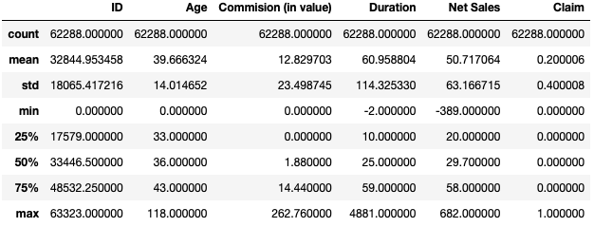
Dataset and Data dictionary (List of features available for analysis and prediction) describing the data in statistical way
Gender as a feature has more than 50% data value as Null. We would be dropping the feature from analysis.
ID as a feature has more than 80% unique data values. We would be dropping the feature from analysis as it does not seem to add value to learning algorithm.
Duplicate records do exist but cannot we would not be discarding them. Such data seem to have a high impact on target variable.

Slide 5
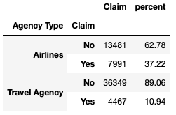
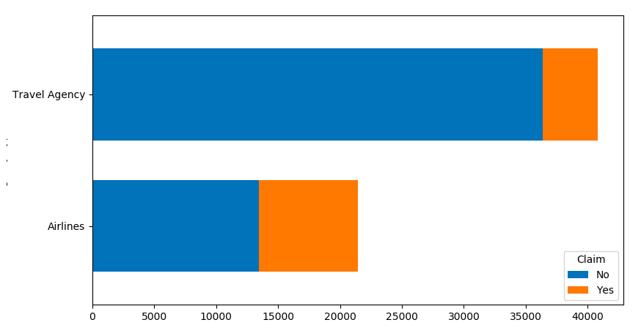
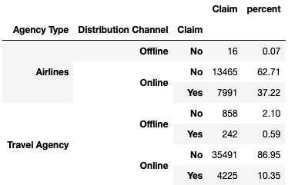
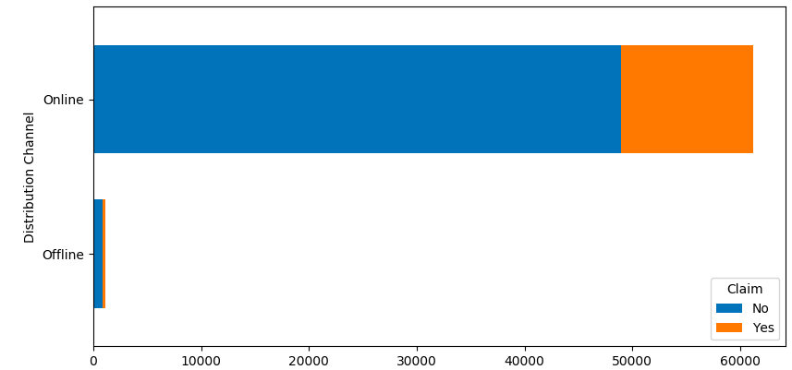
Exploratory Data Analysis - AGENCY TYPE and Distribution channel
Agency Type and Distribution Channels as feature has two unique values each. We would be doing label encoding for these features to incorporate the same into learning algorithm.
Notes:
In case of Airlines Agency, 62% of people are not claiming the insurance however in case Travel Agency 90% of people are not claiming.
So hypothesis is : Risk attached to Airlines business is high though low on sales volumes and Risk attached to Travel Agency is low though high on sales volume
H0 = There is no specific risk associated basis Agency Type as Airline/Travel Insurance
H1 = There is a risk attached to Airlines/Travel insurance business
Basis Chi Square Test H0 is retained. But since for 80% of the data available, Claim Status is 0 so this might have affected our hypothesis testing.
This weightage can be used as one of the parameter while treating categorical to integer while model building for Agency Type column.

Slide 6
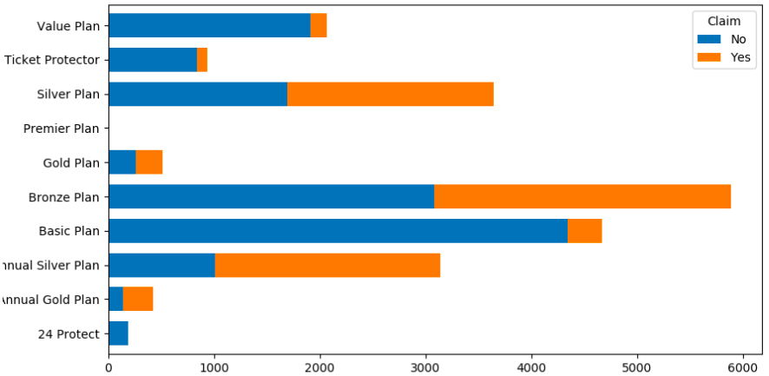
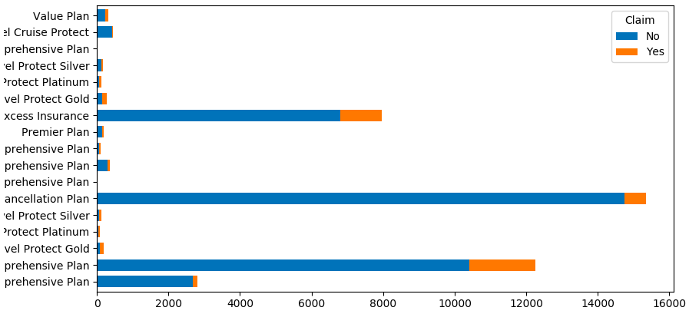
Exploratory Data Analysis - AGENCY TYPE basis Agency type and product name
Agency Type : Airlines
Agency Type : Travel Insurance
Under different Agency Type, there are multiple products and ‘Claim’/’Not Claimed’ status associated with the same. During label encoding we would utilize this percentage in order to add weightage to Product Name feature rather than having plain label encoding/one hot encoding.
Similar approach followed for Agency feature and categorical values replaced with corresponding weightage.
Notes:
In Airlines insurance product, Premier Plan and 24 Protect plans are almost nil risk (also seems least selling plans). Basic Plan and Value plans with moderate claim status Bronz Plan though highest selling also has considerable amount of claims.
In Travel Agency insurance product, Cancellation plan is highest selling but with lower claim status and maximum of plans are not that much sold.

Slide 7
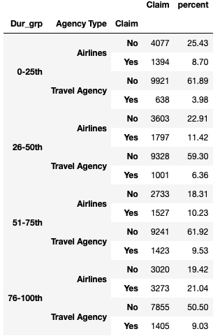
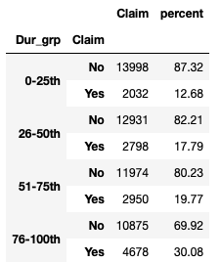
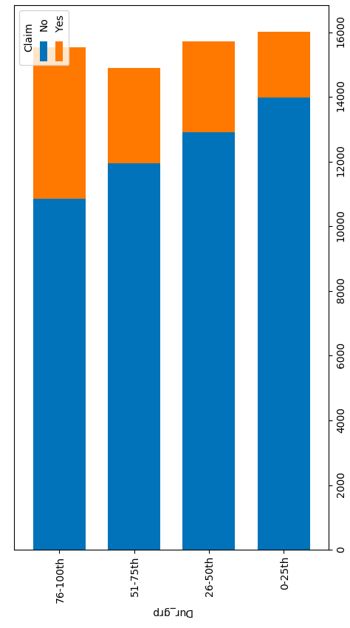
Exploratory Data Analysis – Duration converting available data into quartiles
Duration as a feature is highly right skewed and for the visualization we have binned it into four quarters.
It is also observed, higher duration policy are showing more claims.
Notes:
Percentile of Duration almost evenly distributed across Claims. But as Duration increases, Claims also increases. Longer the Duration of policy, more percentage of Claims observed.

Slide 8
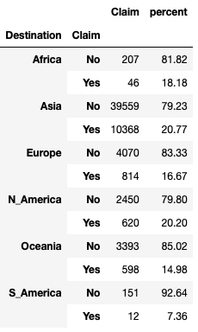
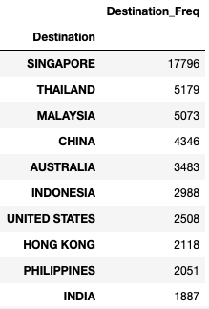
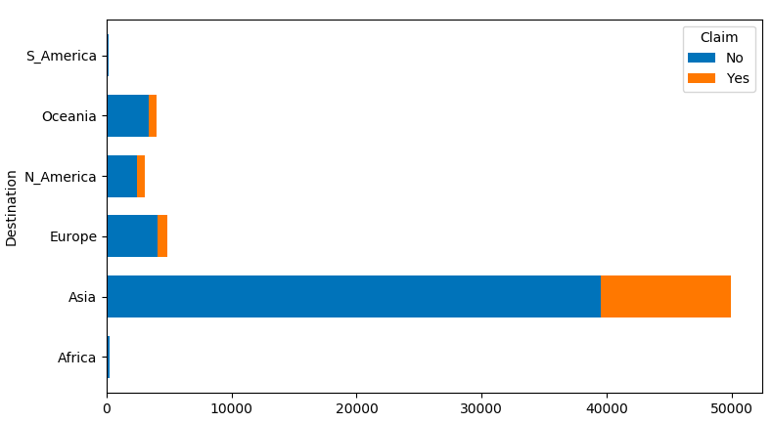
Exploratory Data Analysis – destination categorizing country into continents
For visualization purpose, we did encode Destination feature into continents and it showed majority of business into Asia sector. However this simple encoding would not be helping our model to learn.
As an approach, we used Destination’s frequency as a weightage and replaced destination name with it’s frequency.
Notes:
The insurance business is mainly associated in Asia Market. So insurance claim status data in Asia market might influence our ML model in training phase.

Slide 9
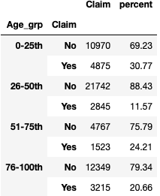
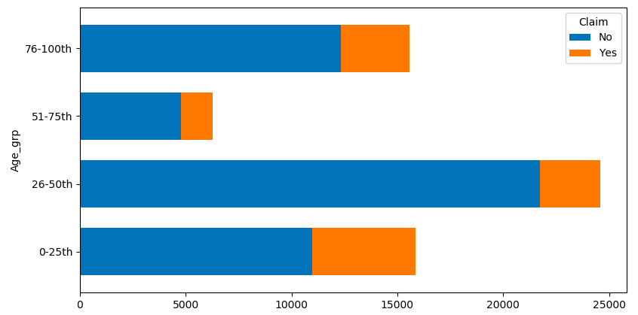
Exploratory Data Analysis – Age converting available data into quartiles
Age as a feature is binned basis four quarters for visualization purpose. It is observed, most of the data is clubbed between 25th and 50th percentile.
While training on algorithm, we binned the Age feature basis hardcoded values ages corresponding to categories of Kids, Adult, Old Age, Very Old Age.

Slide 10
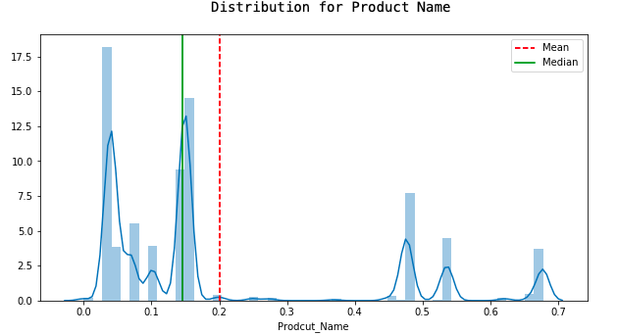
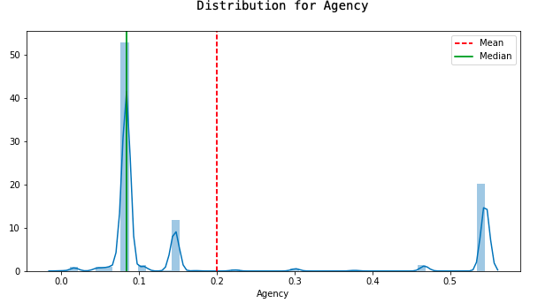
Exploratory Data Analysis – Understand Skewness
Skewness for Product_Name : 1.2232003690715925
Skewness for Agency : 1.1787271018903287

Slide 11
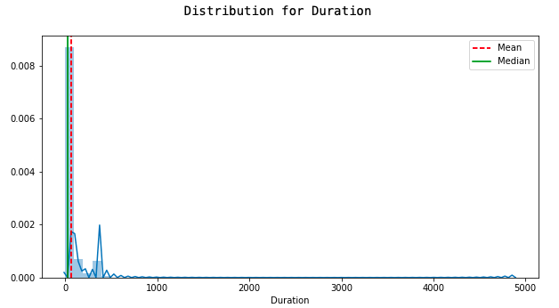
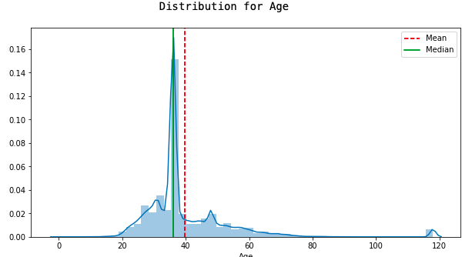
Exploratory Data Analysis – Understand Skewness
Skewness for Duration : 14.86293030692259
Skewness for Age : 2.8657213946192903
Duration has a mean of 60 with SD of 114 ! And skewness of 14 ! Such high skewness would not be suitable to train the model.
As an approach, we would be taking logarithmic transformation for Duration feature to reduce on skewness and bring the data points in a definite range of values.

Slide 12
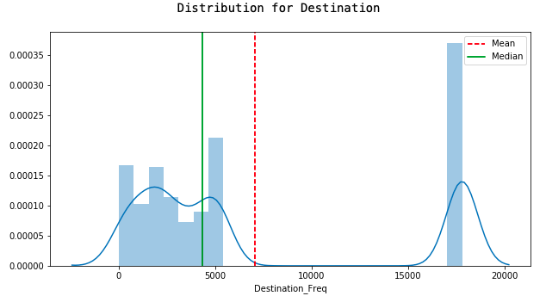
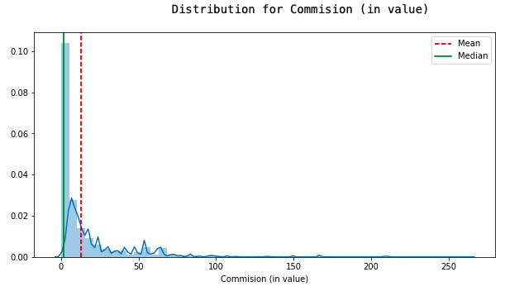
Exploratory Data Analysis – Understand Skewness
Skewness for Destination : 0.8041989200085571
Skewness for Commision : 3.3676428263223404

Slide 13
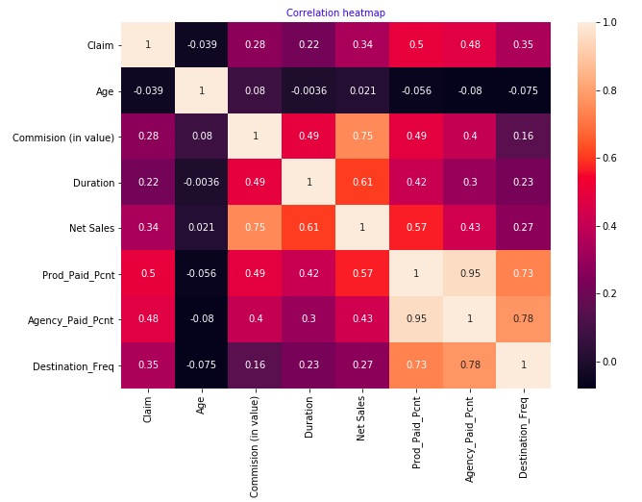
Exploratory Data Analysis – Understand Correlation
High correlation ( 0.75 ) between Net Sale and Commision. There exist multicollinearity.
High correlation ( 0.95 ) between Agency and Product Name. There exist multicollinearity.

Slide 14
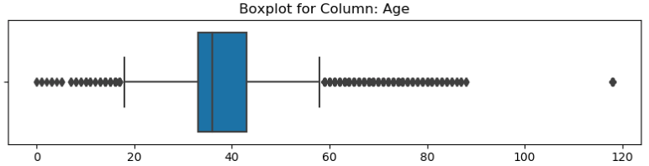
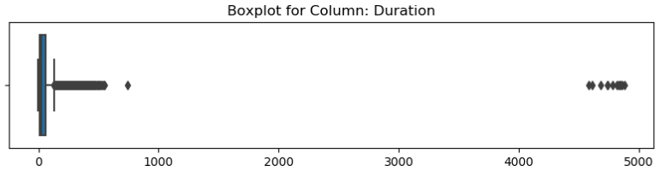
Exploratory Data Analysis – outliers visualization
Age as a feature has outliers. We would not be discarding as they have a high impact on target variable.

Slide 15
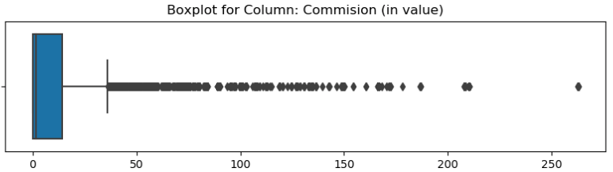
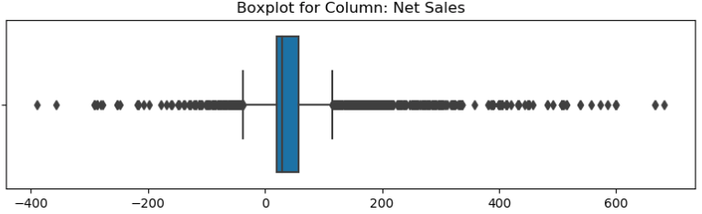
Exploratory Data Analysis – outliers visualization

Slide 16
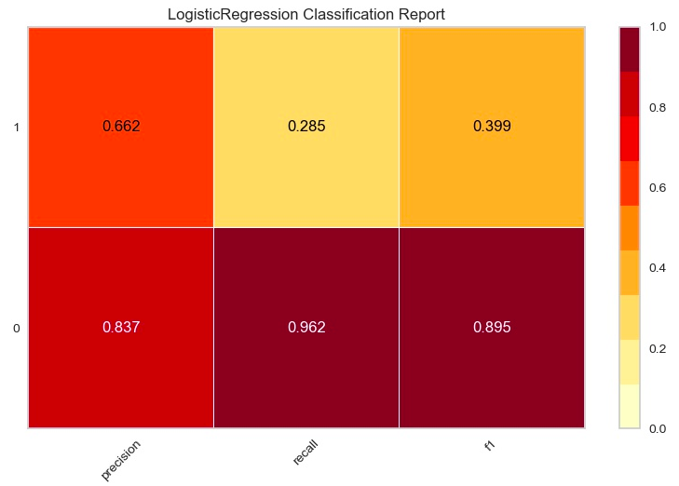
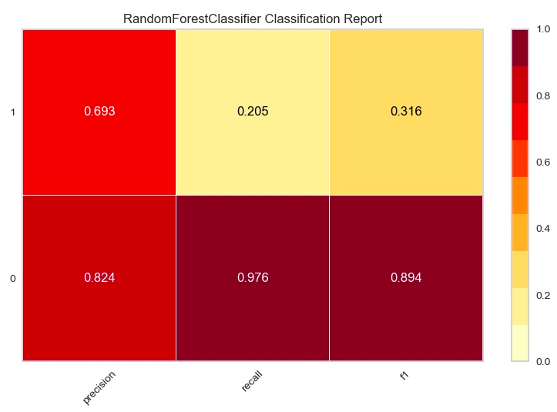
model evaluation matrix
Logistic Regression Evaluation for Baseline Model
Random Forest Classifier Evaluation for Baseline Model
Precision – What percent of your predictions were correct? Precision is the ability of a classifier not to label an instance positive that is actually negative.
Recall – What percent of the positive cases did you catch? Recall is the ability of a classifier to find all positive instances.

Slide 17
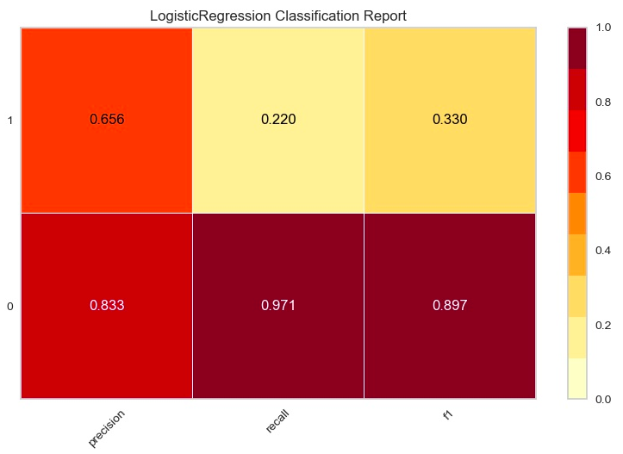
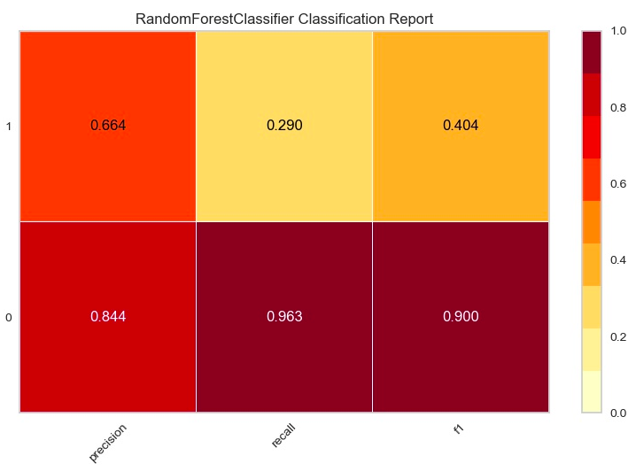
model evaluation matrix
Logistic Regression Evaluation for Final Model
Random Forest Classifier Evaluation for Final Model
461 IDs predicted be CLAIM POSITIVE
15111 IDs predicted to be CLAIM NEGATIVE
898 IDs predicted be CLAIM POSITIVE
14674 IDs predicted to be CLAIM NEGATIVE
Important Features for Random Forest
Prod_Paid_Pcnt | 0.530905
Destination_Freq | 0.227095
Net Sales | 0.166357
Duration_log | 0.075574
Distribution Channel_encoded | 6.91E-05

